Slide 1
服务计算原理与应用

Slide 2
第8章 服务发布与发现: UDDI
Services Publication and Discovery: UDDI

Slide 3
Web服务发布与发现: UDDI
Universal Description Discovery and Integration (UDDI)
  查找服务提供者的统一和系统的方法
  类似于电话号码簿
Specifications
  Schemas for service and business description
  Query and update API for the registry
WS-I compatible
Based on XML, HTTP, IP, SOAP, WSDL standards
发展历程 :
  2000年9月，IBM, Ariba, Microsoft提出
  2001年3月2.0版
  2002年7月3.0版发布后交给OASIS标准化
  2003年8月UDDI3.0标准发布
Notes:
The Universal description, discovery, and integration specifications offer users a unified
and systematic way to find service providers through a centralized registry of services.
It is roughly equivalent to an automated online “phone directory” of Web Services.
UDDI provides two basic specifications that define a service registry’ s structure and
operation. First, it specifies schemas to encode information about businesses that deploy WSs and
Schemas to encode information about WSs themselves. Second, it provides a query and
update API for the registry that describes how information can be accessed and updated.
UDDI is a WS-I compatible specification.
UDDI is based on XML, HTTP, IP, SOAP, WSDL standards.
UDDI 3.0 has been released in August 2003.

Slide 4
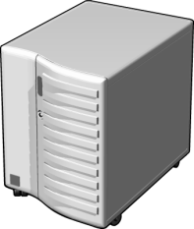




使用 UDDI 的概述
5
1
Pricing Web 服务
UDDI 注册表
3
4
2
1
Web 服务开发商生成并发布 Pricing Web 服务
2
Web 服务开发商注册并分类 Web 服务
3
Web 服务消费者在 UDDI 中查询 Pricing 服务
4
Web 服务消费者选择最合适的 Pricing 服务
5
Web 服务开发者创建解决方案访问 Web 服务的数据

Slide 5
使用 Web 服务的完整过程
1
在企业内部网、外部网或互联网中搜索 UDDI 注册表发现所需的服务
2
使用 UDDI 注册表提供的信息获得 WSDL 服务描述文档
3
根据 WSDL 文档创建基于 SOAP 消息的代理类
4
从 Web 服务客户端调用 Web 服务方法

Slide 6
UDDI 数据结构
Business: 提供服务实体的信息
tModel: 服务的规范描述
提供商的名字、联系
方法、描述以及业务领域
指向 WSDL 文档
Service: 特定服务的描述信息
服务的名字、描述和分类
Binding: 服务入口点的技术信息
服务的访问入口

Slide 7
UDDI 常用类
BusinessEntity
  描述在 UDDI 注册表中注册过服务的提供商
BusinessService
  描述具体的 Web 服务
BindingTemplate
  绑定特定 Web 服务所需的技术信息
AccessPoint
  描述 Web 服务的入口点
TModelInstanceInfo
  描述和 UDDI 规范相关的信息
TModel
  服务描述元数据

Slide 8
UDDI信息和数据结构
UDDI注册条目存储了web服务的公共信息
  白页: 商业实体的基本信息。information such as name, address, i.e. contact details
  黄页: 标准商业分类法信息。information such as categorization of businesses or services
  绿页: 进行交易的技术细节信息。information such as technical data about services
Notes:
UDDI encodes three types of information about WSs. UDDI registry entries stores
published information in following general categories.
White Pages provide contact information such as name, address, telephone number of a business
Yellow Pages provide information that categorize businesses on certain existing non-electronic standards
Green Pages provide information about the published WSs for remote systems to bind to them.

Slide 9
UDDI定义了描述商业和它们的服务的元素
businessEntity
  provides information, including identifiers, contact information etc…
  [white-pages information]
  includes one or more businessService (service entity) elements that represents the services it provides
  specifies a categoryBag to categorize the business [yellow-pages information]
  a unique key identifies each businessEntity
Notes:
UDDI registry is organized around two fundamental entities that describe businesses and the services they provide.
First entity is businessEntity.
Business entity
provides information, including identifiers, contact information etc. [white-pages information]
includes one or more businessService (service entity) elements that represents the services it provides
specifies a categoryBag to categorize the business [yellow-pages information]
a unique key identifies each businessEntity

Slide 10
例子
Business Key
Business Name
<businessEntity businessKey=
“A687FG00-56NM-EFT1-3456-098765432124”>
<name>Acme Travel Incorporated</name>
<description xml:lang=“en”>
Acme is a world leader in online travel services
</description>
<contacts>
<contact useType=“US general”>
<personName>Acme Inc.</personName>
<phone>1 800 CALL ACME</phone>
<email useType=““>acme@acme-travel.com</email>
<address>….</address>
</contact>
</contacts>
<businessServices>
...
….
</businessServices>
<identifierBag> ...
</identifierBag>
<categoryBag> ...
<keyedReference tModelKey=
“UUID:DB77450D-9FA8-45D4-A7BC-04411D14E384”
keyName=“Electronic check-in”
keyValue=“84121801”/>
</categoryBag>
</businessEntity>
Services
Category
Notes:
No comments.

Slide 11
UDDI定义了描述商业和它们的服务的元素
businessService (service entity)
  includes information such as name, description. [white-pages information]
  uniquely identified by a service key
  specifies a categoryBag to categorize the service [yellow-pages information]
  contains a list of bindingTemplates which in turn contains tModelInstanceDetails encoding the technical service information [green-pages information]
  includes reference to its host with a businessKey
Notes:
Second entity is service entity.
businessService entity
includes information such as name, description. [white-pages information]
uniquely identified by a service key
specifies a categoryBag to categorize the the service [yellow-pages information]
contains a list of bindingTemplates which in turn contains tModelInstanceDetails encoding the technical service information [green-pages information]
includes reference to its host with a businessKey

Slide 12
例子
Service Key
<businessService serviceKey=
“894B5100-3AAF-11D5-80DC-002035229C64”
businessKey=“D2033110-3AAF-11D5-80DC-002035229C64”>
<name>ElectronicTravelService</name>
<description xml:lang=“en”>Electronic Travel Service</description>
<bindingTemplates>
<bindingTemplate bindingKey=
“6D665B10-3AAF-11D5-80DC-002035229C64”
serviceKey=“89470B40-3AAF-11D5-80DC-002035229C64”>
<description>
SOAP-based e-checkin and flight info
</description>
<accesssPoint URLType=“http”>
http://www.acme-travel.com/travelservice
</accessPoint>
<tModelInstanceDetails>
<tModelInstanceInfo tModelKey=“D2033110-3BGF-1KJH-234C-09873909802”>
...
</tModelInstanceInfo>
</tModelInstanceDetails>
</bindingTemplate>
</bindingTemplates>
<categoryBag>
...
</categoryBag>
</businessService>
Service Name
Binding Template
tModelDetails
Category
Notes:
No comments.

Slide 13
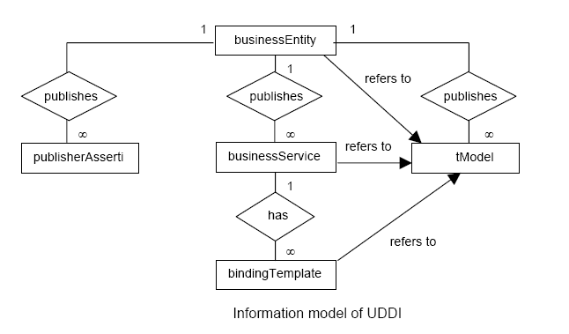
UDDI 信息模型
Notes:
The information model of UDDI registry is shown in the following figure.
A business entity refers to a service provider which is detailed by business name, business key,
description, contact, a list of business categories to which this provider belongs, and a list of
business services that it provides.
A business entity may also be associated with publisher assertions that specify providers that provide
particular service.
A business name is identified by service name, service key, description, a list of service categories to which
this service belongs, and a list of binding templates.
A business service is identified by service name, service key, description, a list of categories to which the
service belongs, and a list of binding templates.
A binding template defines the way to get an instance of the service and is described by binding key,
Description and access point( e.g. link to a service interface).
Business types, service types and interfaces can be defined as tModel and reused among various
businesses, services and binding templates.

Slide 14
tModel
A WSDL document is registered as a tModel into UDDI registry
  为了充分描述服务，引用外部信息，这样可以支持任意的信息类型和格式
tModel 对应 WSDL的抽象接口
The tModel idea:
  to better describe a service we tend to reference information
  such information type or format should not be anticipated
  replacing such information about a service with a unique key provides a reference to arbitrary information types
Notes:
A WSDL document is registered as a tModel into UDDI registry
tModel is a UDDI construct to refer an interface describing WSDL document.
The tModel is to better describe a service we tend to reference information whose
type or format should not be anticipated. Replacing such information about a
service with a unique key provides a reference to arbitrary information types.
For instance; OPEN GIS consortium defines a standard WSDL interfaces and bindings for
Web Map Services. In this case, we first create a tModel to represent such WDSL
Definitions. Any service endpoints that implements those interfaces then can include
the corresponding tModels in their instance-details list.
To this end users and implementers of compliant services must be aware of the
registered tModels and their keys.

Slide 15
tModels for Categorization
Using categorization, UDDI directory can be queried for specific type of services.
Each classification in a taxonomical system is registered as a tModel.
Three standard taxonomies cited by UDDI are
  North American Industry Classification System (NAICS) taxonomy – an industry classification
  The Universal Standard Products and Services Code System (UNSPSC) taxonomy – a classification of products and services
  The International Organization for Standardization Geographic taxonomy (ISO 3166)
Notes:
Using categorization, we can query the UDDI directory to locate very
Specific types of services.
To identify taxonomial systems each classification system itself is
registrered as a tModel in the UDDI registry. Taxonomy information
Is encoded as name-value pairs qualified by a tModel key reference
that identifies which taxonomy each pair belongs to.
There are three standard taxonomies are cited by UDDI as following.
North American Industry Classification System (NAICS) taxonomy – an industry classification
The Universal Standard Products and Services Code System (UNSPSC) taxonomy – a classification of products and services
The International Organization for Standardization Geographic taxonomy (ISO 3166)

Slide 16
例子
<tModel tModelKey=““>
<name>http://www.travel.org/e-checkin-interface</name>
<description xml:lang=“en”>
Standard service interface definition for travel services
</description>
<overviewDoc>
<description xml:lang=“en”>
WSDL Service Interface Document
</description>
<overviewURL>
http://www.travel.org/services/e-checkin.wsdl
</overviewURL>
</overviewDoc>
<categoryBag> ...
</categoryBag>
</tModel>
Notes:
No comments.

Slide 17
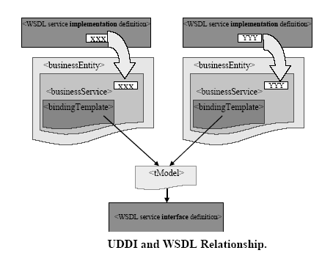
UDDI 和 WSDL的关系
Notes:
The WSDL service interface definition is published in UDDI as a tModel; that is, the tModel contains some
information that is copied from the interface definition (such as name and description) and also contains
a pointer to the WSDL interface definition for all other relevant information(such as the request schema
response schema).
The WSDL service implementation definition is published in UDDI as a businessService.
Currently, UDDI and WSDL allow the implementer of a WS to define and publish the means of
for communicating with the service and allow a consumer of the service to discover and use
the service in an automated way.

Slide 18
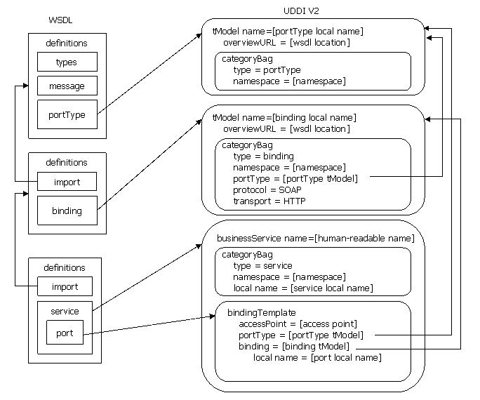
mapping of WSDL 1.1 to UDDI V2 data model
WSDL data model
UDDI data model
Notes:
This mapping describes a methodology for mapping WSDL 1.1 definitions to the UDDI V2 and UDDI V3 data models.
The methodology maps each WSDL artifact to a separate UDDI entity, accurately representing the “building block” design of WSDL descriptions.
wsdl:portType and wsdl:binding elements map to uddi:tModel entities,
wsdl:service elements map to uddi:businessService entities and
wsdl:port elements map to uddi:bindingTemplate entities.
KeyedReferences provide a mechanism to express additional metadata
and to represent a relationship between two UDDI entities.
Source: http://www.oasis-open.org/committees/uddi-spec/doc/tn/uddi-spec-tc-tn-wsdl-v200-20031104.htm

Slide 19
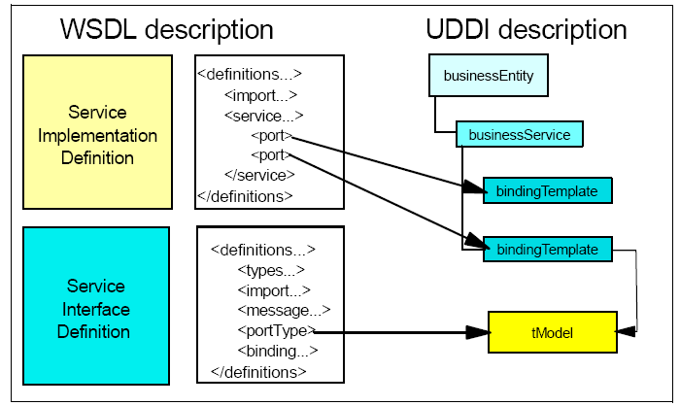
WSDL和UDDI的绑定

Slide 20
<?xml version="1.0" encoding="utf-8"?>
<definitions name="StockQuote" targetNamespace="http://example.com/stockquote/" xmlns:tns=http://example.com/stockquote/
xmlns:xsd1="http://example.com/stockquote/schema/" xmlns:soap=http://schemas.xmlsoap.org/wsdl/soap/
xmlns="http://schemas.xmlsoap.org/wsdl/">
<types>
<schema
targetNamespace="http://example.com/stockquote/schema/"
xmlns="http://www.w3.org/2001/XMLSchema">
<element name="TradePriceRequest">
<complexType><all><element name="tickerSymbol" type="string"/></all></complexType>
</element>
<element name="TradePrice">
<complexType><all><element name="price" type="float"/></all></complexType>
</element>
</schema>
</types>
<message name="GetLastTradePriceInput">
<part name="body" element="xsd1:TradePriceRequest"/>
</message>
<message name="GetLastTradePriceOutput">
<part name="body" element="xsd1:TradePrice"/>
</message>
<portType name="StockQuotePortType">
<operation name="GetLastTradePrice">
<input message="tns:GetLastTradePriceInput"/>
<output message="tns:GetLastTradePriceOutput"/>
</operation>
</portType>
<binding name="StockQuoteSoapBinding" type="tns:StockQuotePortType">
….
</binding>
<service name="StockQuoteService"> <port name="StockQuotePort" binding="tns:StockQuoteSoapBinding">
<soap:address location="http://location/sample"/> </port>
</service>
</definitions>
“Input\Output” Details
A sample WSDL file
input
- 1 portType
1 binding
1 service
1 port
output
“Method” Specification
“Binding” Details
Notes:
Consider the following WSDL sample based on the WSDL document presented in the WSDL 1.1 specification.[6] This example shows how this one WSDL document is decomposed into two tModels (one for the portType and one for the binding) and one businessService with one bindingTemplate. It then shows the kinds of UDDI API queries that can be used for the purpose of discovery.
Note that this WSDL document has one portType, one binding, one service, and one port. As such, this sample represents the simplest WSDL document. Also note that the location of this WSDL is at http://location/sample.wsdl.

Slide 21
UDDI portType tModel
<tModel tModelKey="uuid:e8cf1163-8234-4b35-865f-94a7322e40c3" >
<name>
StockQuotePortType
</name>
<overviewDoc>
<overviewURL>
http://location/sample.wsdl
<overviewURL>
<overviewDoc>
<categoryBag>
<keyedReference
tModelKey="uuid:d01987d1-ab2e-3013-9be2-2a66eb99d824"
keyName=”portType namespace”
keyValue=”http://example.com/stockquote/” />
<keyedReference
tModelKey="uuid:6e090afa-33e5-36eb-81b7-1ca18373f457"
keyName=”WSDL type”
keyValue="portType" />
</categoryBag>
</tModel>
tModel name
overviewDoc
categoryBag
Notes:
The WSDL portType entity maps to a tModel.
The tModel name is the same as the WSDL portType local name.
The tModel contains a categoryBag that specifies the WSDL namespace, and it indicates that the tModel is of type “portType”.
The overviewDoc provides a pointer to the WSDL document.

Slide 22
UDDI binding tModel
<tModel tModelKey="uuid:49662926-f4a5-4ba5-b8d0-32ab388dadda">
<name>
StockQuoteSoapBinding
</name>
<overviewDoc>
<overviewURL>
http://location/sample.wsdl
</overviewURL>
</overviewDoc>
<categoryBag>
<keyedReference
tModelKey="uuid:d01987d1-ab2e-3013-9be2-2a66eb99d824"
keyName=”binding namespace”
keyValue=”http://example.com/stockquote/” />
<keyedReference
tModelKey="uuid:6e090afa-33e5-36eb-81b7-1ca18373f457"
keyName=”WSDL type”
keyValue="binding" />
<keyedReference
tModelKey="uuid:082b0851-25d8-303c-b332-f24a6d53e38e"
keyName=”portType reference”
keyValue="uuid:e8cf1163-8234-4b35-865f-94a7322e40c3" />
<keyedReference
tModelKey="uuid:4dc74177-7806-34d9-aecd-33c57dc3a865"
keyName=”SOAP protocol”
keyValue= “uuid:aa254698-93de-3870-8df3-a5c075d64a0e” />
<keyedReference
tModelKey="uuid:e5c43936-86e4-37bf-8196-1d04b35c0099"
keyName=”HTTP transport”
keyValue=" uuid:68DE9E80-AD09-469D-8A37-088422BFBC36" />
<keyedReference
tModelKey="uuid:c1acf26d-9672-4404-9d70-39b756e62ab4"
keyName=”uddi-org:types”
keyValue="wsdlSpec" />
</categoryBag>
</tModel>
overviewDoc
a keyedReference
categoryBag
Notes:
The WSDL binding entity maps to a tModel. The tModel name is the same as the WSDL binding local name.
The tModel contains a categoryBag that specifies the WSDL namespace, it indicates that the tModel is of type “binding”, it supplies a pointer to the portType tModel, and it indicates what protocols are supported by the binding.
keyedReference
The wsdlSpec keyedReference ensures that users can find the tModel using the conventions defined in the Version 1 Best Practice.
The overviewDoc provides a pointer to the WSDL document.

Slide 23
UDDI businessService and bindingTemplate
<businessService
serviceKey="102b114a-52e0-4af4-a292-02700da543d4"
businessKey="1e65ea29-4e0f-4807-8098-d352d7b10368">
<name>Stock Quote Service</name>
<bindingTemplates>
<bindingTemplate
bindingKey="f793c521-0daf-434c-8700-0e32da232e74”
serviceKey="102b114a-52e0-4af4-a292-02700da543d4">
<accessPoint URLType="http">
http://location/sample
</accessPoint>
<tModelInstanceDetails>
<tModelInstanceInfo
tModelKey="uuid:49662926-f4a5-4ba5-b8d0-32ab388dadda">
<description xml:lang="en">
text here…
</description>
<instanceDetails>
<instanceParms>StockQuotePort</instanceParms>
</instanceDetails>
</tModelInstanceInfo>
<tModelInstanceInfo
tModelKey="uuid:e8cf1163-8234-4b35-865f-94a7322e40c3">
<description xml:lang="en">
The wsdl:portType that this wsdl:port implements.
</description>
</tModelInstanceInfo>
</tModelInstanceDetails>
</bindingTemplate>
</bindingTemplates>
<categoryBag>
…..
</categoryBag>
</businessService>
business name
bindingTemplate
tModelInstanceDetails
tModelInstanceInfo
Notes:
The WSDL service entity maps to a businessService, and the WSDL port entity maps to a bindingTemplate.
The businessService name should be a human-readable name.
The businessService contains a categoryBag that indicates that this service represents a WSDL service, and it specifies the WSDL namespace and WSDL service local name.
The bindingTemplate specifies the endpoint of the service, and it contains a set of tModelInstanceDetails.
The first tModelInstanceInfo indicates that the service implements the StockQuoteSoapBinding and provides the WSDL port local name.
The second tModelInstanceInfo indicates that the service implements the StockQuotePortType.

Slide 24
The UDDI V1 Programmer’s API
Inquiry API
  Find
    find_business
    find_service
    find_binding
    find_tmodel
  Get details
    get_businessdetail
    get_servicedetail
    get_bindingdetail
    get_tmodeldetail
    get_registeredinfo
Publishers API
  Save
    save_business
    save_service
    save_binding
    save_tmodel
  Delete...
    delete_business
    delete_service
    delete_binding
    delete_tmodel
  Security…
    get_authtoken
    discard_authtoken

Slide 25
UDDI查询
UDDI Search API allows users to query for service providers that provide particular service.
A UDDI query may be for
  A business entity
    Using business name, business key or business category (i.e. find_business())
  A list of publisher assertions
    Using business key (i.e. find_relatedBusiness())
  A business service
    Using the business key of service key and service name (i.e. find_service())
  Service key of a bussiness entity
    Using a binding template (i.e. find_binding())
  A set of business entities and business services adopting same tModel
    Using a tModel (i.e. find_tModel())
After finding the required UDDI entry, a set of API is used to get details of those entries from UDDI
  get_businessDetail(), get_serviceDetail(), get_bindingDetail(), get_tModelDetail()
Notes:
No comments.

Slide 26
Query example - I
Find the businessService for a WSDL service
<find_service generic=”2.0” xmlns=”urn:uddi-org:api_v2”>
<categoryBag>
<keyedReference
tModelKey=”uuid:6e090afa-33e5-36eb-81b7-1ca18373f457”
keyName=”WSDL type”
keyValue=”service” />
<keyedReference
tModelKey="uuid:d01987d1-ab2e-3013-9be2-2a66eb99d824"
keyName=”service namespace”
keyValue=”http://example.com/stockquote/” />
<keyedReference
tModelKey="uuid:2ec65201-9109-3919-9bec-c9dbefcaccf6"
keyName=”service local name”
keyValue="StockQuoteService" />
</categoryBag>
</find_service>
Notes:
Find the businessService for StockQuoteService in the namespace http://example.com/stockquote/.
This should return the serviceKey 102b114a-52e0-4af4-a292-02700da543d4.

Slide 27
Query example - II
Find tModel for portType name
<find_tModel generic=”2.0” xmlns=”urn:uddi-org:api_v2”>
<name>StockQuotePortType</name>
<categoryBag>
<keyedReference
tModelKey=”uuid:6e090afa-33e5-36eb-81b7-1ca18373f457”
keyName=”WSDL type”
keyValue=”portType”/>
<keyedReference
tModelKey=”uuid:d01987d1-ab2e-3013-9be2-2a66eb99d824”
keyName=”portType namespace”
keyValue=”http://example.com/stockquote/”/>
</categoryBag>
</find_tModel>
Notes:
Find the portType tModel for StockQuotePortType in the namespace http://example.com/stockquote/.
This should return the tModelKey uuid:e8cf1163-8234-4b35-865f-94a7322e40c3.

Slide 28
Query example - III
Find bindings for portType
<find_tModel generic=”2.0” xmlns=”urn:uddi-org:api_v2”>
<categoryBag>
<keyedReference
tModelKey=” uuid:6e090afa-33e5-36eb-81b7-1ca18373f457”
keyName=”WSDL type”
keyValue=”binding”/>
<keyedReference
tModelKey=”uuid:082b0851-25d8-303c-b332-f24a6d53e38e”
keyName=”portType reference”
keyValue=”uuid:e8cf1163-8234-4b35-865f-94a7322e40c3”/>
</categoryBag>
</find_tModel>
Notes:
Find all bindings for StockQuotePortType.
This should return the tModelKey uuid:49662926-f4a5-4ba5-b8d0-32ab388dadda.

Slide 29
UDDI 注册库
UDDI registries contains information about businesses and the Services these businesses offer.
  – Public registries
  – Private registries
Notes:
所谓UDDI注册是服务提供者，以及他们在UDDI服务器上发布它的服务。包括两种注册方式：分别是公共注册方式和私有注册方式。下面我们分别介绍。

Slide 30
公共注册库
IBM Public registry Registration: https://uddi.ibm.com/ubr/registry.html
inquiryURL= https://uddi.ibm.com/ubr/inquiryapi
publishURL= https://uddi.ibm.com/ubr/publishapi
Test registry Registration: https://uddi.ibm.com/testregistry/registry.html
inquiryURL= https://uddi.ibm.com/testregistry/inquiryapi publishURL= https://uddi.ibm.com/testregistry/publishapi
Notes:
所谓公共注册方式使用全球性的UDDI注册中心进行注册 。主要的全球性的注册中心包括：IBM公共注册中心，IBM测试注册中心、 HP公共注册中心、 微软公共注册中心和SAP公共注册中心.

Slide 31
公共注册库
HP
Registration: http://uddi.hp.com
inquiryURL = http://uddi.hp.com/ubr/inquire
publishURL = https://uddi.hp.com/ubr/publish
Microsoft
Registration: http://uddi.rte.microsoft.com inquiryURL=http://uddi.rte.microsoft.com/inquire publishURL=https://uddi.rte.microsoft.com/publish
SAP
Registration: http://udditest.sap.com inquiryURL=http://uddi.sap.com/UDDI/api/inquiry/ publishURL=https://uddi.sap.com/UDDI/api/publish/

Slide 32
私有注册库
Operate your own registry for testing purposes
Establish your own registry of Services for your own organization
Trust issue
Notes:
所谓的私有注册就是建立本地本组织内的注册服务器，提供局部的服务注册和发现服务

Slide 33
UDDI的局限性
tModels are not stored in UDDI registries themselves. A unique identifier referencing a tModel is contained in the registries.
There is no uniform way of querying about services, service interfaces and classifications.
UDDI does not support WSDL security
Notes:
The interface (describe as a WSDL file) is referred to by a UDDI construct called TModel,
and is not contained in the UDDI registration itself. As a result in UDDI, there is no uniform
way of querying about services, their interfaces and their classifications.
UDDI provides limited query ability. For instance it allows business type information such
as contact info to be searched.
A clear requirement for UDDI is that the contents of the registry data must be trustworty.
If a user cannot trust registry data, there will be no reason to use the registry for service discovery.

Slide 34
谢谢
The End

